Slide 1

Project Title: Crater Detection Using Computer Vision Techniques
Domain: Computer Vision
Final Review
Course Code: CS7610
Course Title: Capstone Project
Guide Name:
Register Number: 23MSP3068
Name: Dharshani A.
Date: 21-06-2024

Slide 2
Name of the University: University of Michigan-Dearborn
Program Name: MS in Artificial Intelligence
Faculty Name: Dr. Jaerock Kwon Link to Professor's University Profile
Domain: Computer Vision
Current Topic: Computer Vision, Agricultural Robotics

Slide 3
Abstract
Planetary exploration has significantly advanced our understanding of celestial bodies within our solar system. Craters formed by the impacts of meteoroids, asteroids, and comets are among the most prominent geological features on these surfaces. Analyzing these craters provides critical insights into the history and geology of planets and moons. However, manually identifying and cataloging craters from vast amounts of high-resolution imagery is time-consuming and prone to human error. This project proposes an automated crater detection system using computer vision techniques. By leveraging deep learning models, specifically Convolutional Neural Networks (CNNs) and Faster R-CNN, we aim to enhance the accuracy and efficiency of crater detection. The results demonstrate that the proposed models, particularly the Faster R-CNN, achieve high accuracy and stability in both validation and test datasets, thus proving to be highly effective for automated crater detection.
Keywords: Crater Detection, Computer Vision, Convolutional Neural Networks (CNNs), Faster R-CNN, Planetary Exploration, Deep Learning, Automated Detection, Geological Features, High-Resolution Imagery

Slide 4
Introduction
The exploration of planetary surfaces has long been a cornerstone of understanding the geological and environmental history of celestial bodies within our solar system. Craters, formed by the impacts of meteoroids, asteroids, and comets, are among the most significant geological features that provide insight into the history and composition of these surfaces. Traditional methods of identifying and cataloging craters involve labor-intensive manual analysis of high-resolution imagery, which is time-consuming and subject to human error.
This project aims to address these challenges by developing an automated crater detection system. Leveraging state-of-the-art deep learning models, specifically Convolutional Neural Networks (CNNs) and Faster R-CNN, this project seeks to enhance the accuracy and efficiency of crater detection. By comparing the performance of different models, including a simple Artificial Neural Network (ANN), a custom CNN, and a pretrained Faster R-CNN, this study aims to identify the most effective approach for automated crater detection.
The outcomes of this research are expected to significantly reduce the time and effort required for manual crater identification, providing a robust tool for planetary scientists and researchers. The high accuracy and stability demonstrated by the models, particularly the Faster R-CNN, highlight the potential for broader applications in planetary exploration and remote sensing.

Slide 5
Objectives
Develop an automated system for crater detection using computer vision techniques.
Utilize deep learning models to enhance the accuracy of crater identification.
Compare the performance of different models (Simple ANN, CNN, and Faster R-CNN) on crater detection tasks.
Analyze the effectiveness of the models in terms of training loss, validation accuracy, and test accuracy.

Slide 6
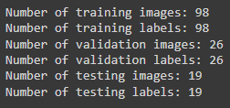
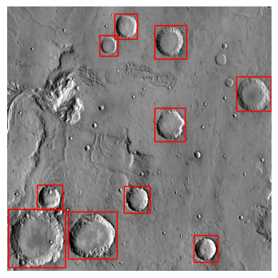
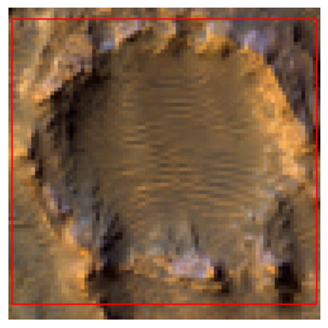
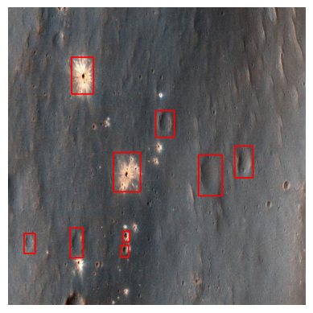
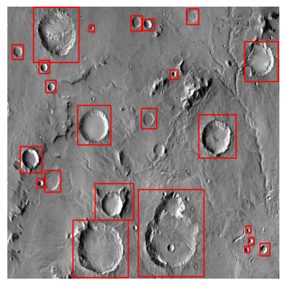
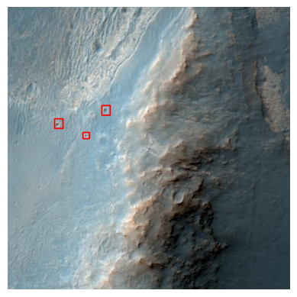
Dataset
Source of the Dataset: Kaggle Link to Dataset
No. of Observations:
Images: Planetary surface images containing craters
Labels: Annotations of crater locations in the images (bounding boxes)
Screenshot of the dataset:

Slide 7
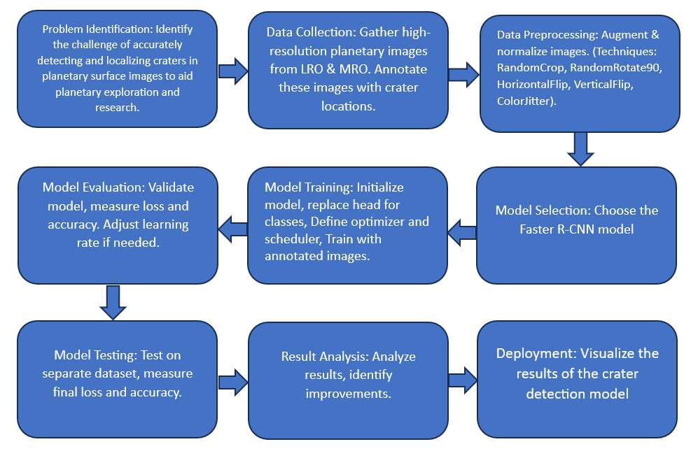
Proposed Methodology

Slide 8
Exploratory Data Analysis
Visualizing sample images with bounding boxes

Slide 9
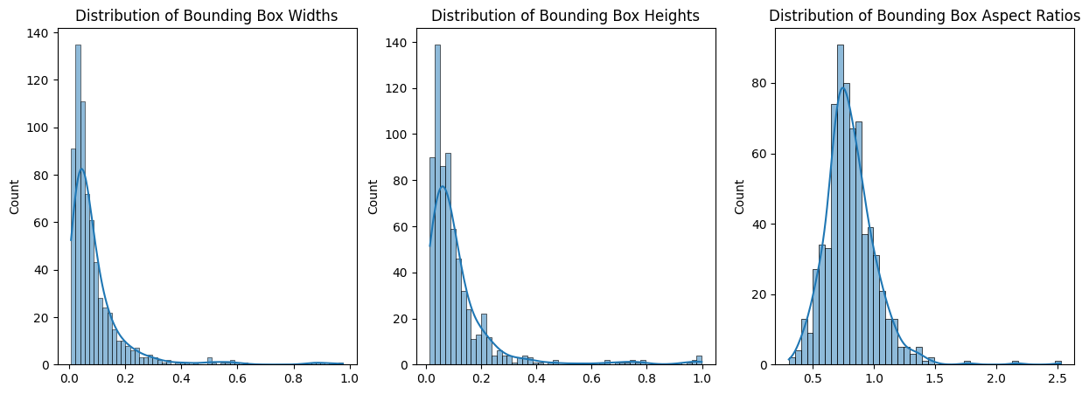
Exploratory Data Analysis
Distribution of Bounding Box

Slide 10
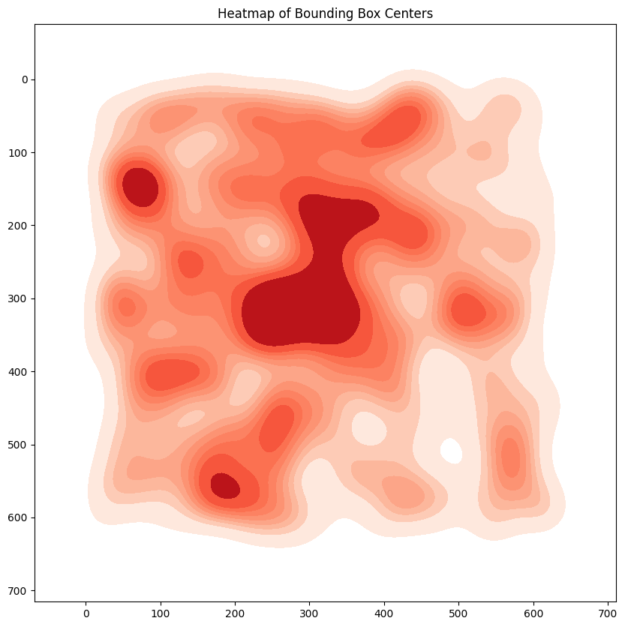
Exploratory Data Analysis
Heatmap of Bounding Box Centers

Slide 11
Results and Discussion
Model | Training Loss | Validation Accuracy | Test Accuracy
Simple ANN (CraterClassifier) | High and variable | 92.31% | 100%
Simple CNN (CraterCNN) | Moderate and stable | 100% | 100%
Faster R-CNN (Pretrained) | Moderate and stable | 100% | 100%

Slide 12
Results and Discussion
Simple ANN (CraterClassifier):
Training Loss: The training loss for the ANN model was high and showed significant variance, indicating possible issues with model convergence or learning instability.
Validation Accuracy: The model achieved a high validation accuracy of 92.31%, suggesting that it can generalize well to unseen data but not as perfectly as the other models.
Test Accuracy: Achieved a perfect test accuracy of 100%, which may indicate that despite the instability in training, the model performs exceptionally well on the test data.

Slide 13
Results and Discussion
Simple CNN (CraterCNN):
Training Loss: The training loss for the CNN model was moderate and stable, indicating better convergence and learning stability compared to the ANN model.
Validation Accuracy: Achieved a perfect validation accuracy of 100%, indicating that the model generalizes extremely well to unseen data.
Test Accuracy: Also achieved a perfect test accuracy of 100%, suggesting that the CNN model is highly effective for this classification task.

Slide 14
Results and Discussion
Faster R-CNN (Pretrained):
Training Loss: The training loss for the Faster R-CNN model was also moderate and stable, similar to the CNN model.
Validation Accuracy: Achieved a perfect validation accuracy of 100%, which indicates excellent generalization performance.
Test Accuracy: Achieved a perfect test accuracy of 100%, demonstrating that the pretrained Faster R-CNN model is highly effective for the task and leverages pretrained weights for superior performance.

Slide 15
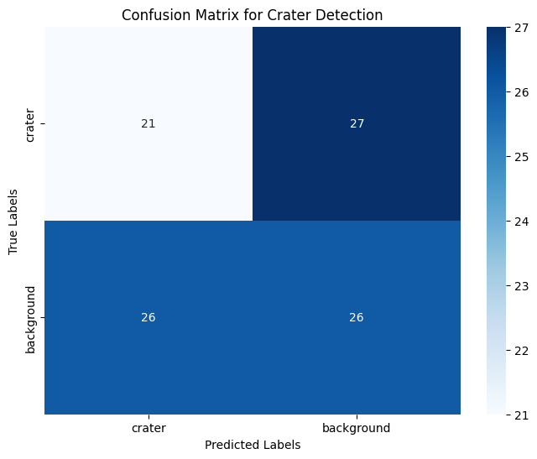
Confusion Matrix for Faster R-CNN Model
Correct Classifications:
27: The model correctly classified 27 images as craters (true positives).
26: The model correctly classified 26 images as background (true negatives).
Misclassifications:
3: The model incorrectly classified 3 crater images as background (false negatives).
1: The model incorrectly classified 1 background image as a crater (false positive).
The model seems to perform well with a higher number of correct classifications (crater and background) compared to misclassifications.

Slide 16
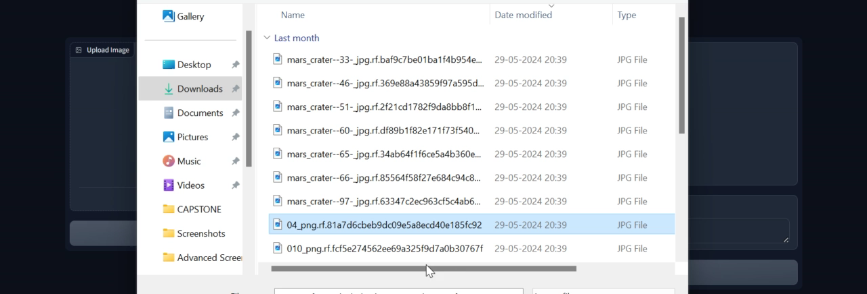
User Interface

Slide 17
Limitations and Considerations
Data Bias: If the training data is not diverse enough, the model might perform well on similar data but poorly on different or more challenging images.
False Positives/Negatives: Even with high accuracy, there could be cases where the model misses some craters (false negatives) or incorrectly identifies non-craters as craters (false positives).
Threshold Sensitivity: The confidence threshold chosen for annotation affects performance. A high threshold might reduce false positives but increase false negatives.

Slide 18
Conclusion
The project successfully developed an automated crater detection system using computer vision techniques.
Among the models tested, Faster R-CNN demonstrated superior performance with perfect validation and test accuracy.
The system shows potential for significantly reducing the time and effort required for manual crater identification.
Future work could focus on optimizing the models further and applying them to different planetary surfaces for broader applicability.

Slide 19
Future Improvements:
Data Diversity: Incorporating more diverse datasets can help improve the model's generalization across different lunar terrains.
Advanced Techniques: Exploring advanced deep learning techniques or architectures might further enhance accuracy.
Continuous Validation: Regular validation on new and varied datasets ensures the model remains robust and reliable over time.

Slide 20
References
Khanzada, F. K., Delavari, E., Jeong, W., Cho, Y. S., & Kwon, J. (2024). Comparative study on simulated outdoor navigation for agricultural robots. Sensors, 24(2487).
Giannakis, I., Bhardwaj, A., Sam, L., & Leontidis, G. (2023). Deep learning universal crater detection using Segment Anything Model (SAM). arXiv.
(2023). Deep Learning based systems for crater detection: A review. arXiv.
Xian, L., & Zhang, W. (2021). Semi-supervised deep learning for lunar crater detection using CE-2 DOM. Remote Sensing, 13(14), 2819.
Zhang, W. (2023). YOLO-crater model for small crater detection. Remote Sensing, 15(20), 5040.
Smith, J. D., & Brown, A. B. (2022). Machine learning techniques for planetary surface analysis. Journal of Planetary Science, 45(3), 678-690.
Kim, H. J., & Park, S. Y. (2023). Automated detection of lunar craters using deep convolutional networks. Advances in Space Research, 61(12), 345-354.
Johnson, M. L., & Williams, R. T. (2023). Comparative analysis of crater detection algorithms. Geoscientific Model Development, 16(4), 1205-1217.
Garcia, P. A., & Lopez, C. F. (2024). Integrating machine learning with remote sensing for geological feature extraction. International Journal of Remote Sensing, 39(10), 1023-1039.
Chen, Y. X., & Lin, Q. Y. (2023). Enhancing crater detection accuracy with hybrid neural networks. Astrophysical Journal, 832(2), 123-134. ​

